Slide 1
SMART DUSTBIN USING IOT
Project on
Presented By:-
Bhabani Sahu
Sasmita Rani Mandal
Pradeep Sundar Maharana
Saswat Pradhan
Kshitij Chandra Nayak
Guided By:-
Mr. Susant Kumar Behera,
Faculty of MCA,
CIME,BBSR.

Slide 2
Contents
Introduction
Why Smart Bin ?
Components
Technology used
Working Principal
Advantages & Disadvantages
Conclusion
References

Slide 3
Introduction
Waste management is all the activities and actions required to manage waste from its inception to its final disposal. This includes collection, transportation, treatment and disposal of waste together with monitoring and regulation.
Waste and wastes are unwanted or unusable materials.
Waste is any substance which is discarded after primary use, or it is worthless, defective and of no use
Curbside collection .
It is an inevitable consequence .

Slide 4
Why Smart Bin
Increase in Population.
Pollution
Air
Water etc.
Working load .
Smart to Manage .

Slide 5
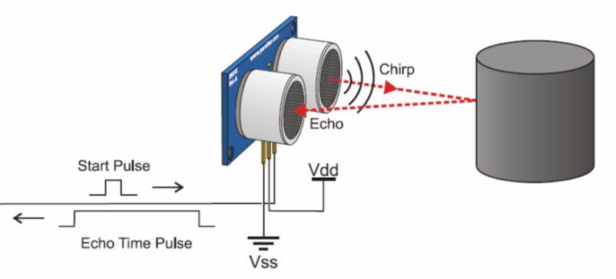
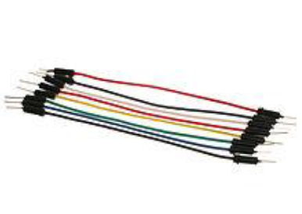
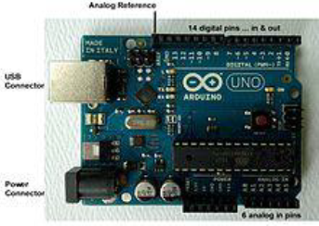
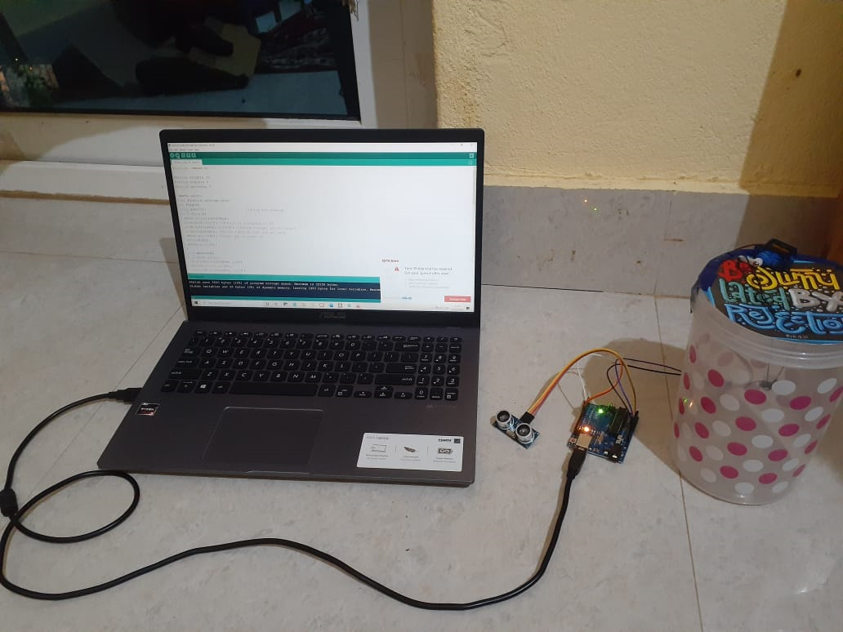
Components
GARBAGE CONTAINER
ULTRASONIC SENSOR
ARDUINO BOARD
JUMP WIRES

Slide 6
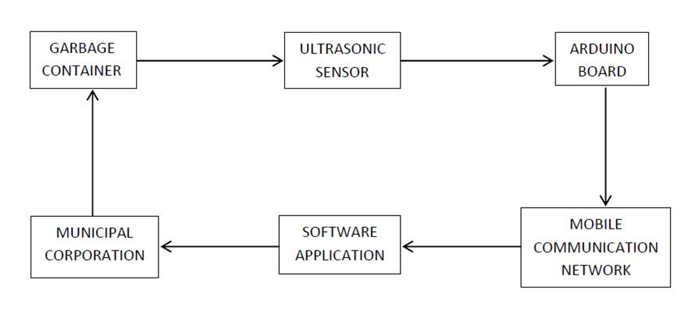
Working Principal
The sensor is fixed on to the bread board. The connection between the Arduino board and sensor is made with the help of connecting wires. The working program is fed into the Arduino board. The GSM module is also connected to the same Arduino board with the help of wires. The power supply to the system is given with the help of a battery.
BLOCK DIAGRAM

Slide 7
Old vs New

Slide 8
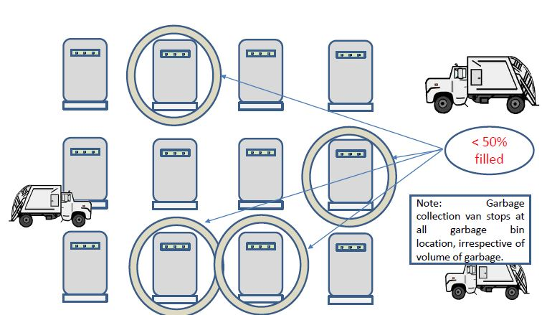

Slide 9
Advantages
Less time and fuel consumption .
Decreased noise, traffic flow and air pollution .
Provide real time information on the fill level .
Reducing manpower required to handle the garbage collection .
Being a Smart Citizen of Smart City .

Slide 10
Disadvantage
Need powerful sensor

Slide 11
Conclusion
By using this method the collection of waste in the city becomes easier. It helps in reducing air pollution, traffic flow, man power, time and money. With the help of proper technology (GPS & SOFTWARE APPLICATIONS) we can guide the trucks in selecting the shortest path for garbage collection. This project can add an edge to the cities aiming to get smart and people-friendly.

Slide 12
References
1. Glossary of Environment Statistics : Series F, No. 67 / Department for Economic and
Social Information and Policy Analysis, United Nations. New York: UN, 1997.
2. United Nations Environmental Programme (2013). "Guidelines for National Waste
Management Strategies Moving from Challenges to Opportunities."
3. "Arduino - Introduction". arduino.cc.
4. "Programming Arduino Getting Started with Sketches". McGraw-Hill. Nov 8, 2011.
Retrieved 2013-03-28.
5. "GSM Global system for Mobile Communications". 4G Americas. Retrieved 2014-03-
6. The national environment policy, 2006 available at
http://www.tnpcb.gov.in/pdf/nep2006e.pdf

Slide 13
Any Query Related to This…?

Slide 14
Thank You..

